Slide 1

Mid-Point Presentation Group 22
Shane Mulrooney
Sean Fulton
Cree Gunning

Slide 2

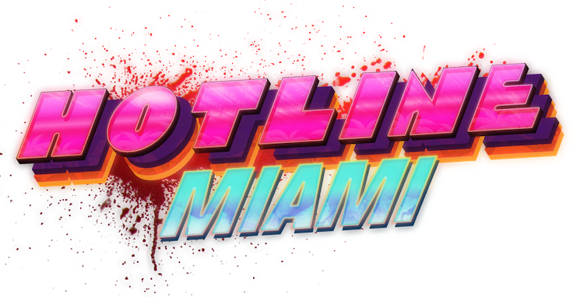
Application Idea (Shane)
Video game application
Borrowed inspiration from multiple games
Call of Duty: Zombies
Hotline Miami
Merged genres to create something unique

Slide 3
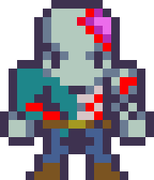

Target Audience (Shane)
For fans of:
Top-down shooter genre
Endless round-based games
Pixel-art styled games

Slide 4
Technologies Used (Cree)

Slide 5
Project Plan (Cree)

Slide 6
Progress So Far (Sean)

Slide 7
Challenges Faced (Sean)

